Slide 1
بسم الله الرحمن الرحیم

Slide 2
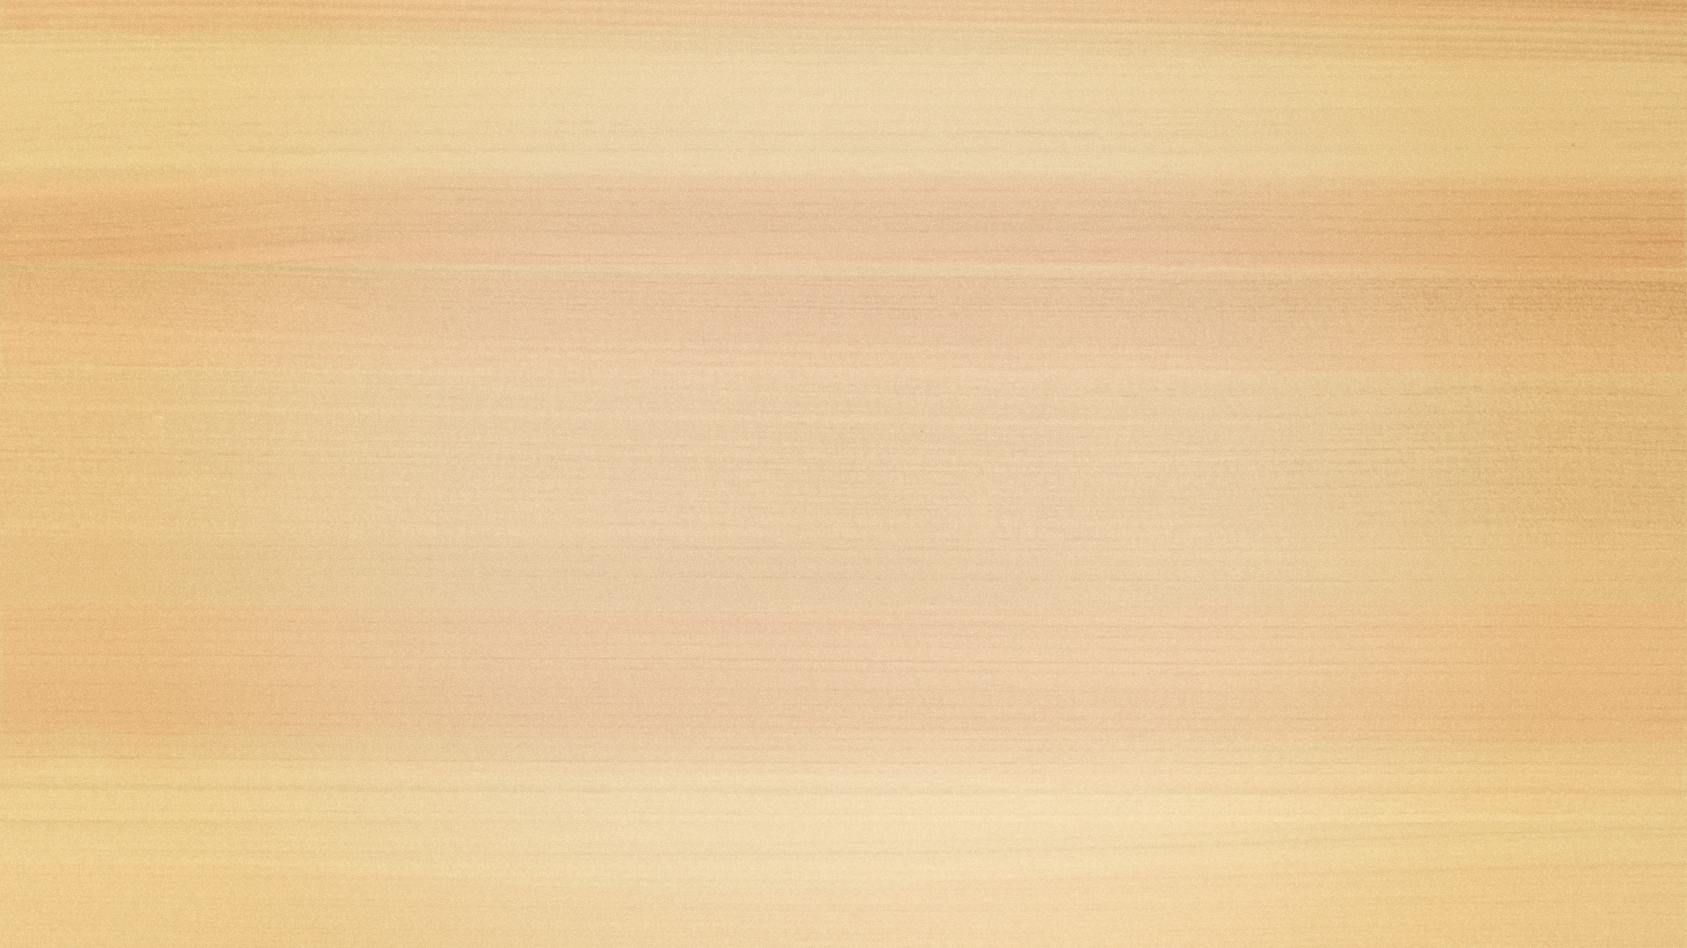

د افغانستــان اسلامـــي امارت د لـــوړو زده کړو وزارت کندهار پوهنتون کمپيوټر ساينس پوهنځی
color detection
لارښود استاد: نويداحمد
ترتیب کوونکی: محمد الله محمدي
کال:۱۴۰۲ لمریز

Slide 3
دګروف غړی
خالد احمد
نوراحمد
محمد عسی
محمد الله
شفیع الله

Slide 4

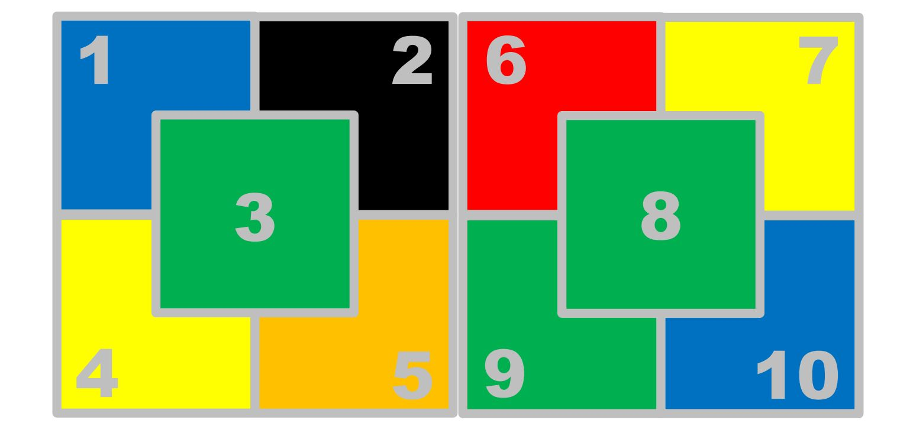
What is color detection
Color detection refers to the process of identifying and distinguishing different colors within an image or a physical object. This can be done through the use of technology such as color sensors, cameras, or software programs that are able to analyze and interpret the colors present

Slide 5
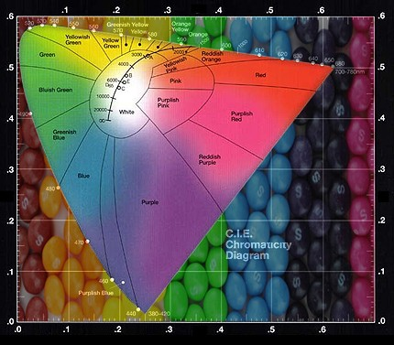
Why do use color detection
Color detection is used for a variety of reasons, including:
Quality control: This can help to maintain consistency and quality in the final products.
Sorting and categorization: Color detection is often used in sorting and categorizing objects based on their color. This can be useful in industries such as agriculture, recycling and logistics.
Image processing: This can be used for tasks such as color correction, enhancement, and editing.

Slide 6
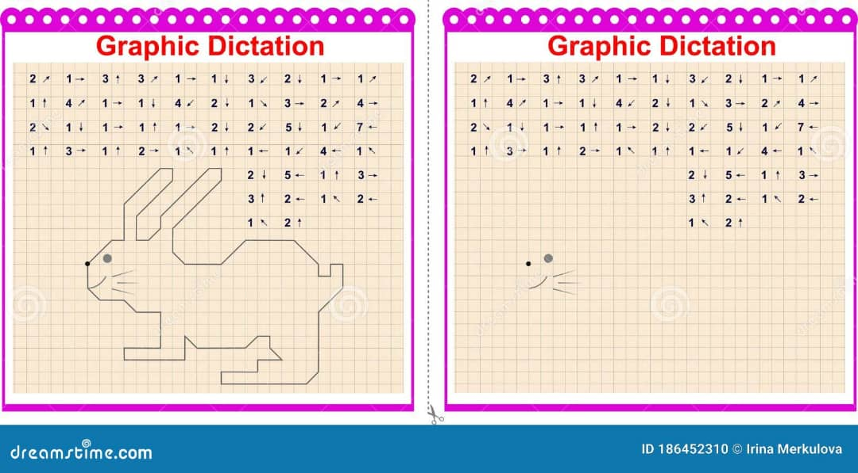
Continues …
. Accessibility: Color detection technology can also be used to assist individuals with color vision deficiencies or other visual impairments.
Automation: Color detection is often used in automated systems and robotics to enable machines to identify and interact with colored objects.

Slide 7
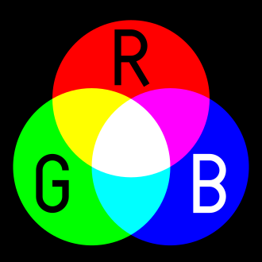
What is RJB color
RJB color refers to a specific color model that uses red, green, and blue as its primary colors. This color model is often used in digital imaging and display technologies, such as computer monitors, TVs, and digital cameras. In the RJB color model, different combinations of red, green, and blue are used to create a wide range of colors, making it a popular choice for digital color representation.

Slide 8
Why do use RJB color
The RJB color model is used because it closely mimics the way the human eye perceives color. By using red, green, and blue as primary colors, the RJB color model is able to create a wide range of colors that are similar to those seen in the natural world. Additionally, digital devices such as computer monitors and TVs use red, green, and blue pixels to create images, so the RJB color model is well-suited for representing colors in these digital displays.

Slide 9
پوښتنې؟

Slide 10
له توجه مو يوه نړۍ مننه!!!

